Slide 1
Studio Web workshop Day 1 – Introduction to Studio Web
Speakers: Lakshman Ganta & Mudhukrishna Lalapet

Slide 2

About Me:
I have 6+ Years of experience into RPA UiPath and around 8 Years of experience in IT Industry
Started My journey as a Java Developer and then moved into RPA
Now associated with Broadridge Financial Solutions as a RPA Technology Lead
I received UiPath MVP award for 2022 & 2023 and also got 14 community awards
from UiPath.

Slide 3

Myself :
Experienced professional in the field of RPA with over 5 years, worked on a wide range of projects across different industries, including finance, healthcare, manufacturing, logistics and currently automotive.
Associated with Forvia as a Technology Lead (AI/ML).
Worked as Software Intern in Indian Space Research Organization(ISRO)
UiPath MVP for 2022 and certified UiPath Community
Trainer.

Slide 4
Agenda
1. Introduction to UiPath Studio Web
2. UiPath Studio Family
3. Why UiPath Studio Web ?
4. Studio Web vs Desktop
5. Studio Web walk-through & Demo
6. Q & A

Slide 5
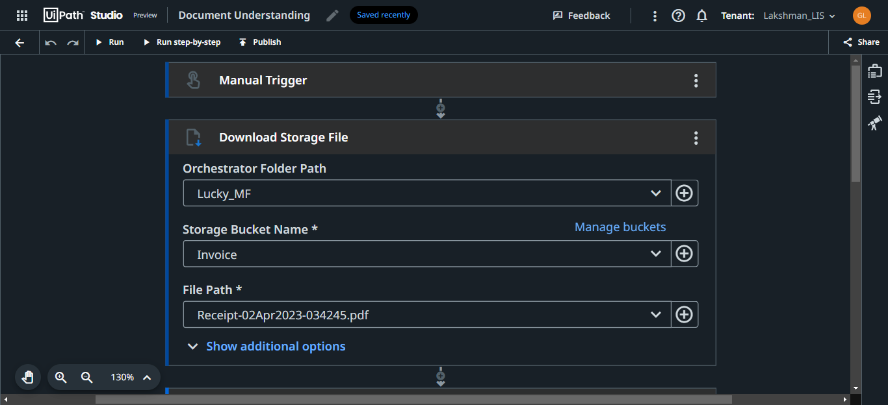
Introduction to Studio Web
Studio Web is a browser-based automation development tool, for users who wish to start automating processes across online applications and tools such as Gsuite, Office 365, IT infrastructure platforms, and more.

Slide 6
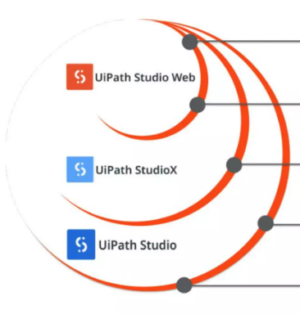
UiPath Studio Family
Your starting point in your automation journey
Develop cross-platform automation & learn the fundamentals through API triggered scenarios & Web based UI Automation
Additionally, automate desktop focused scenarios using native desktop UI Automation & advanced desktop office support
Multiple file support, integrate additional sequences, flowcharts, state machines or even your preferred language low-level code. Advanced debugging & troubleshooting tools
Go back and forth between web & desktop for cross-platform projects.

Slide 7
Why Studio Web ?
The benefits of starting with Studio Web include:
Quick Getting Started
Cross-Platform Ready
Integration Service
Compatible with Studio and StudioX
Schedule based on external events
Browser based UI Automation & Live Streaming
IT Automation Enabler
Easy-to-Deploy DU Scenarios

Slide 8
Studio Web vs Desktop
Studio Web | Studio Desktop
Hosted on UiPath Secure Cloud | A windows desktop application
Accessible from a web browser | Only from a windows machine with .msi installer
Easy and Instant Scalability | Scalability dependent on the machine
Share automations with one click | Share as package only or through external versioning systems
Direct configuration of triggers (with events too) | Triggers can be possible only after package deployment
Dependencies are auto managed | Manual configuration of dependencies and sources
Local file systems/desktop apps can't be used | Any file system or app can be automated

Slide 9
Studio Web Walk-through & Demo

Slide 10




Vibrant ecosystem of more than 2 million professionals and citizen developers learning,
getting support, and succeeding together in their automation careers.
Academy
Learn the skills of the future on UiPath Academy or through our Academic Alliance
Earn globally recognized credentials with UiPath Certifications
Forum
Get crowdsourced support and share product feedback on UiPath Forum
Check the product documentation
Community Events
Connect with like-minded people and share best practices with the UiPath Community
Solve challenges in engaging hackathon competitions
Join meetups and conferences
Join the UiPath Community

Slide 11
Questions?
Ask your Questions in chat or speak up!

